Slide 1
Networking and the Internet
Amrita University.
4-<number>

Slide 2
Networking and the Internet
Network Fundamentals
The Internet
The World Wide Web
4-<number>

Slide 3
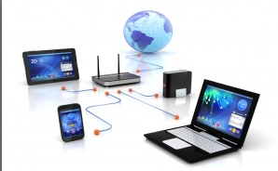
What is Networks?
Need to share information and resources among different computers.
linked computer systems – Networks.
Computers are connected, so that data can be transferred from machine to machine.
Computer users can exchange messages and share resources – Printing, Data Storages…
4-<number>

Slide 4
Network Classifications
Scope
  Personal area network (PAN)
    Short range communications
    Typically less than a few meters
    such as between a wireless headset and a smartphone or
    between a wireless mouse and its PC
  Local area network (LAN)
    Collection of computers in a single building or building complex
    For example, the computers on a university campus or
    Those in a manufacturing plant might be connected by a LAN.
  Metropolitan area (MAN)
    Network of intermediate size, such as one spanning a local community
  Wide area network (WAN)
    Links machines over a greater distance—perhaps in neighbouring cities or on opposite sides of the world.
4-<number>

Slide 5
Network Classifications
Ownership based classification
  Open vs Closed
    whether the network’s internal operation is based on designs that are in the public domain- Internet
      freely circulated and often grow in popularity
    controlled by a particular entity such as an individual or a corporation- proprietary.
      Innovations owned and controlled by a particular entity such as an individual or a corporation
      applications are restricted by license fees and contract conditions E.g., Novell Inc
4-<number>

Slide 6
Network Classifications
Topology
  pattern in which the machines are connected
  Bus (Ethernet)
    machines are all connected to a common communication line
    popularized in the 1990s when
    implemented under a set of standards known as Ethernet, and
    Ethernet networks remain one of the most popular networking systems in use today
  Star (Wireless networks with central Access Point)
    one machine serves as a central focal point to which all the others are connected
4-<number>

Slide 7
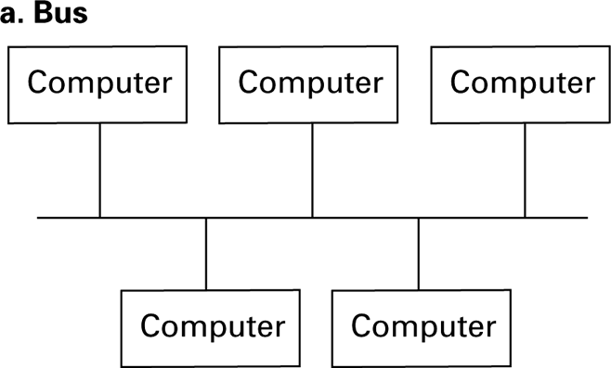
Network topologies
4-<number>

Slide 8
Network Classifications
  Star (Wireless networks with central Access Point)
    one machine serves as a central focal point to which all the others are connected
    has roots as far back as the 1970s
    evolved from the paradigm of a large central computer serving many users
    As the simple terminals employed by these users grew into small computers themselves, a star network emerged.
    popular today in wireless networks
      communication is conducted by means of radio broadcast and
      the central machine, called the access point (AP), serves as a focal point around which all communication is coordinated.
4-<number>

Slide 9
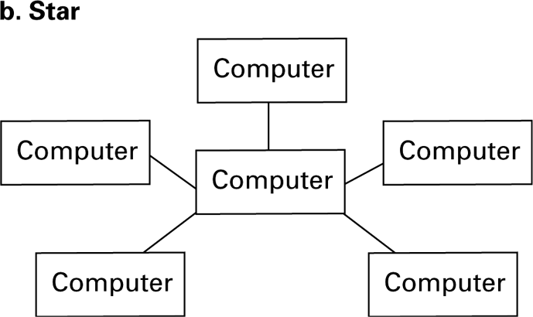
Network topologies (continued)
4-<number>

Slide 10
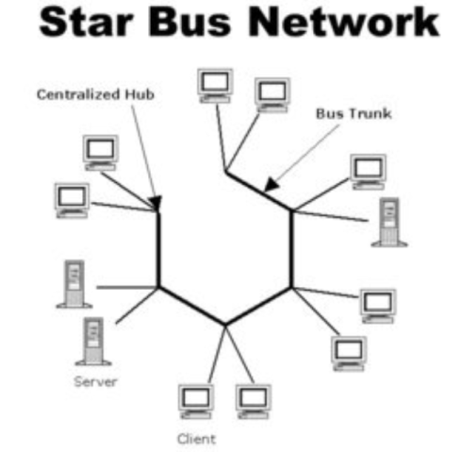
BUS Vs STAR
Not always with the physical arrangement of equipment.
Communicating directly with each other over a common bus or indirectly through an intermediary central machine.
Network that looks like a star network although it operates like a bus network. How?
  Machines are connected with short bus with long link.
  A bus network is created by running links from each computer to a central location where they are connected to a device called a hub.
4-<number>

Slide 11
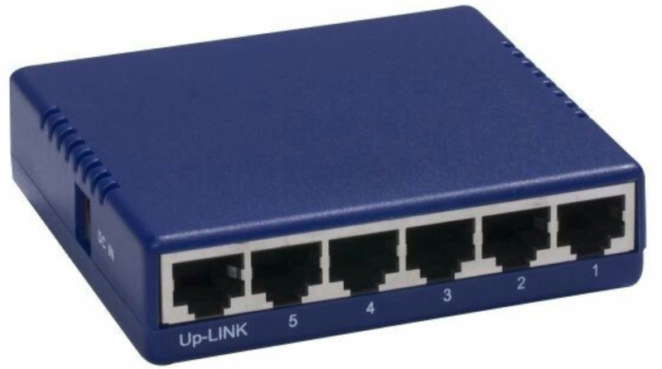
Hub
is little more than a very short bus
relay any signal it receives to all the machines connected to it
with perhaps some amplification
The result is a network that looks like a star network although it operates like a bus network
4-<number>

Slide 12
Protocols
Rules by which activities are conducted by the network
Allows the network to function reliably
  Need of Protocols : Vendors are able to build products for network applications that are compatible with products from other vendors.
Example :
  Problem of coordinating the transmission of messages among computers in a network.
4-<number>

Slide 13
Protocol Standards
development of protocol standards
  an indispensable process in the development of networking technologies
Consider the problem of coordinating the transmission of messages among computers in a network
  Without rules governing this communication,
    all the computers might insist on transmitting messages at the same time or
    fail to assist other machines when that assistance is required.
4-<number>

Slide 14
Protocols
CSMA/CD (Carrier Sense, Multiple Access with Collision Detection) *
  Used in Ethernet
  dictates that each message be broadcast to all the machines on the bus
  Each machine monitors all the messages but keeps only those addressed to itself
  Silent bus provides right to introduce new message
4-<number>

Slide 15
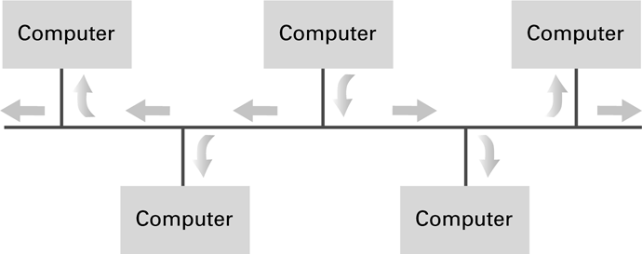
Communication over a bus network
(CSMA/CD )
4-<number>

Slide 16
CSMA-CD Message Transmission
A machine waits until the bus is silent, and at this time it begins transmitting while continuing to monitor the bus.
If another machine also begins transmitting, both machines detect the clash and pause for a brief, independently random period of time before trying to transmit again.
4-<number>

Slide 17
CSMA-CD Drawbacks
not compatible with wireless star networks
all machines communicate through a central AP
a machine may be unable to detect that its transmissions are colliding with those of another
  machine may not hear the other because its own signal drowns out that of the other machine
  the signals from the different machines are blocked from each other by objects or distance even though they can all communicate with the central AP (Hidden Terminal Problem)
4-<number>

Slide 18
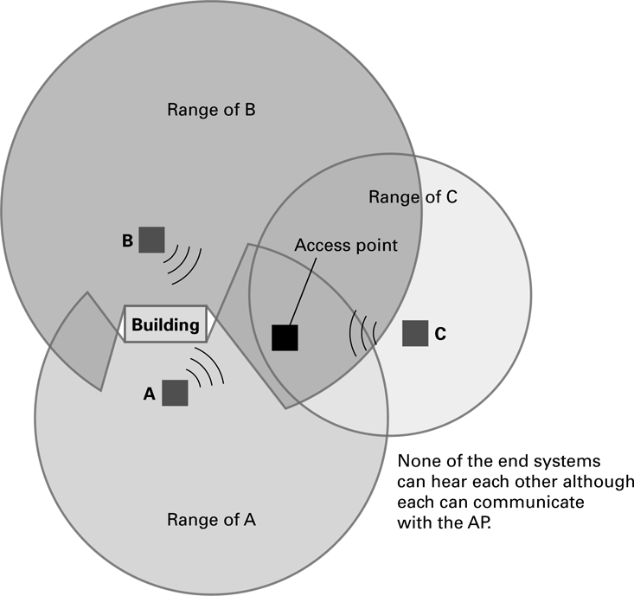
The hidden terminal problem- CSMA-CA *
4-<number>

Slide 19
CSMA/CA (Carrier Sense, Multiple Access with Collision Avoidance) *
Wireless networks adopt the policy of trying to avoid collisions rather than trying to detect them.
Policies are classified as CSMA/CA
  many of which are standardized by IEEE within the protocols defined in IEEE 802.11 and
  commonly referred to as WiFi.
4-<number>

Slide 20
Collision avoidance protocols
Designed to avoid collisions
may not eliminate collisions completely.
When collisions do occur, messages must be retransmitted.
Collision avoidance approach
  based on giving advantage to machines that have already been waiting for an opportunity to transmit
  protocol used is similar to Ethernet’s CSMA/CD
4-<number>

Slide 21
CSMA-CD Vs CSMA-CA
The basic difference is
  when a machine first needs to transmit a message and finds the communication channel silent,
    it does not start transmitting immediately.
    Instead, waits for a short period of time
    starts transmitting only if the channel has remained silent throughout that period.
    If a busy channel is experienced during this process, the machine waits for a randomly determined period before trying again
    Once this period is exhausted, the machine is allowed to claim a silent channel without hesitation
4-<number>

Slide 22
Collision avoidance
Collisions between “newcomers” and those that have already been waiting are avoided because
  a “newcomer” is not allowed to claim a silent channel until any machine that has been waiting is given the opportunity to start.
4-<number>

Slide 23
Solving the hidden terminal problem
Not solved by CSMA-CA
  each individual station be able to hear all the others to distinguish silent/busy channels
some WiFi networks require that
  each machine send a short “request” message to the AP wait until the AP acknowledges that request before transmitting an entire message
  If the AP is busy because it is dealing with a “hidden terminal,” it will ignore the request,
  the requesting machine waits.
  Otherwise, the AP will acknowledge the request, and the machine transmits.
4-<number>

Slide 24
Wi-Fi networks
  all the machines in the network will hear all acknowledgments sent from the AP
  Machines have a good idea of whether the AP is busy at any given time
  machines may not be able to hear the transmissions taking place.
4-<number>

Slide 25
Connecting Networks
Connect existing networks to form an extended communication system
can be done by connecting the networks to form a larger version of the same “type” of network
Example
  connect the buses to form a single long bus in ethernet networks
  achieved by means of different devices known as
  Repeater: Extends a network
  Bridge: Connects two compatible networks
  Switch: Connects several compatible networks
  Router: Connects two incompatible networks
    resulting in a network of networks called an internet *
4-<number>

Slide 26
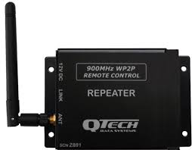
Repeater
Little more than a device
Passes signals back and forth between the two original buses
usually performs some form of amplification
Doesn’t consider the meaning of the signals
4-<number>

Slide 27
Bridge
A is similar to, but more complex than, a repeater.
Connects two buses (like a repeater)
Does not necessarily pass all messages across the connection.
Looks at the destination address accompanying each message and forwards the message to the destined computer on the other side of the connection.
4-<number>

Slide 28
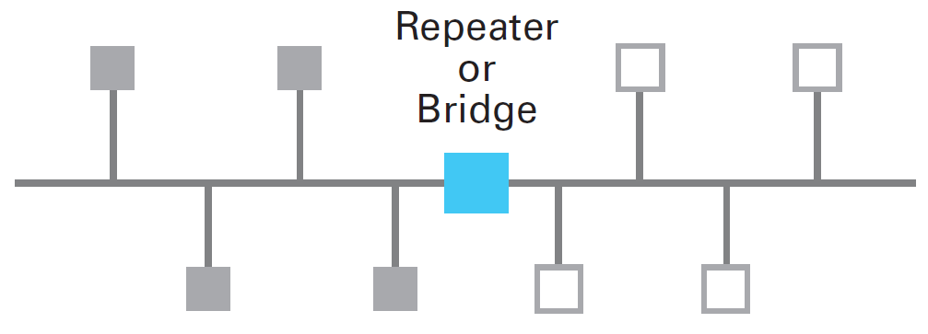
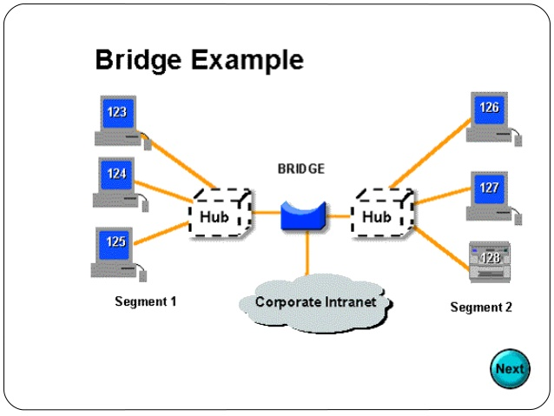
Bridge
Two machines residing on the same side of a bridge can exchange messages without interfering with communication taking place on the other side.
A bridge produces a more efficient system than that produced by a repeater.
4-<number>

Slide 29
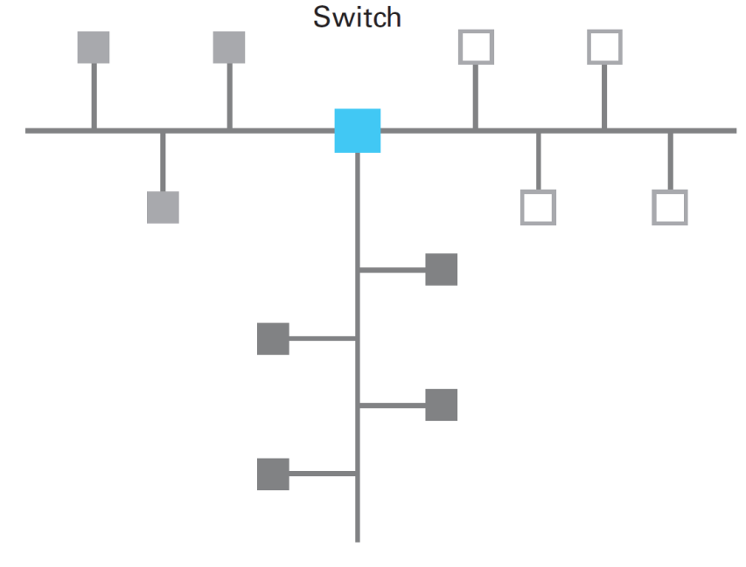
Switch
Essentially a bridge with multiple connections
Connects several buses rather than just two
Produces a network consisting of several buses extending from the switch as spokes on a wheel
4-<number>

Slide 30
Switch
Considers the destination addresses of all messages
Forwards only those messages destined for other spokes (similar to bridge)
Each message that is forwarded is relayed only into the appropriate spoke hence
Minimizes the traffic in each spoke.
4-<number>

Slide 31
Large Networks
Result of connecting networks via repeaters,
bridges, and switches
The entire system operates in the same manner (using the same protocols) as each of the original smaller networks.
4-<number>

Slide 32
Network Incompatibilites
Sometimes networks to be connected have incompatible characteristics
Example
  the characteristics of a Wi-Fi network are not readily compatible with an Ethernet network
  Solution: Network of networks (a.k.a internet)
The original networks maintain their individuality and continue to function as autonomous networks
4-<number>

Slide 33
Routers
Devices to handle connections between networks to form an internet
Actually special purpose computers used for forwarding messages
Task of a router is different from that of repeaters, bridges, and switches
Routers provide links between networks while allowing each network to maintain its unique internal characteristics
4-<number>

Slide 34
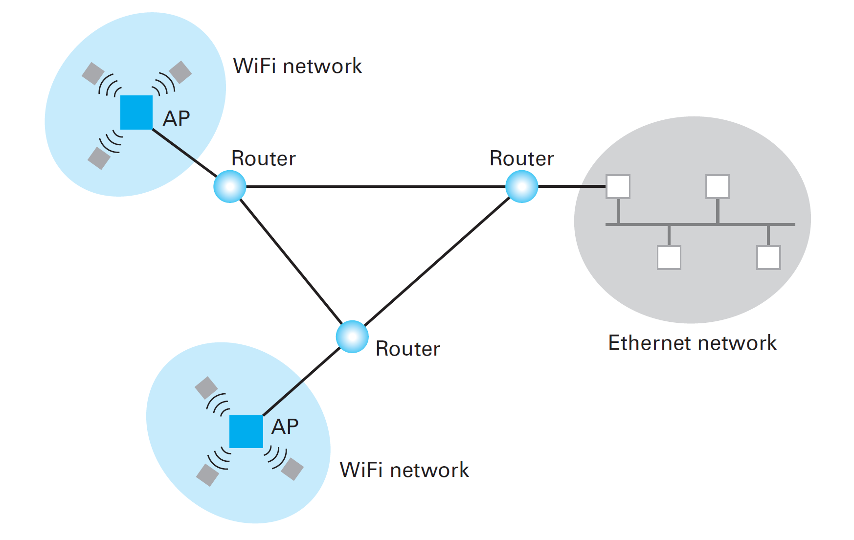
Two WiFi star networks and an Ethernet bus network
connected by routers
4-<number>

Slide 35
Working of the (previous) Network
When a machine in one of the Wi-Fi networks wants to send a message to a machine in the Ethernet network,
  it first sends the message to the AP in its network.
  From there, the AP sends the message to its associated router
  this router forwards the message to the router at the Ethernet.
    The ethernet router forwards the message to a machine on the bus
    that machine then forwards the message to its final destination in the Ethernet.
4-<number>

Slide 36
Forwarding process of the router using Addressing Mechanism
Based on an internet-wide addressing system.
All the devices in an internet (including the machines in the original networks and the routers) are assigned unique addresses.
Each machine in one of the original networks has two addresses:
  its original “local” address within its own network and
  its internet address.
4-<number>

Slide 37
How does Addressing work?
A machine wanting to send a message to a machine in a distant network attaches the internet address of the destination to the message and directs the message to its local router
From the local router it is forwarded in the proper direction using “forwarding table”.
4-<number>

Slide 38
Forwarding Table
Maintained by each router.
Contains the router’s knowledge about
  the direction in which messages should be sent depending on their destination addresses.
4-<number>

Slide 39
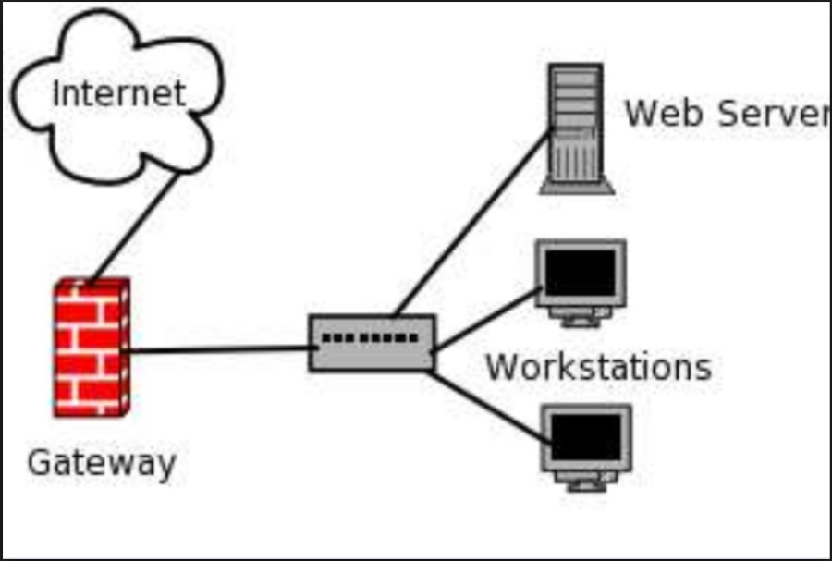
Gateway
The “point” at which one network is linked to an internet
it serves as a passageway between the network and the outside world
Can be found in a variety of forms
4-<number>

Slide 40
Gateway
In many cases a network’s gateway is merely the router
  throughwhich it communicates with the rest of the internet.
In other cases the term gateway may be used to refer to more than just a router.
The term Gateway is hence used loosely
4-<number>

Slide 41
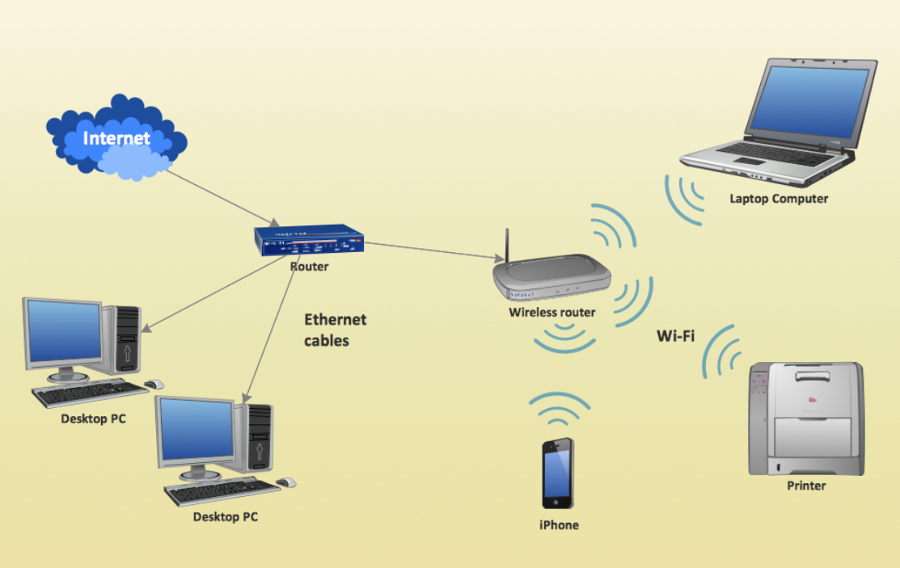
Gateway - Example
In most residential WiFi networks connected to the Internet, the term gateway refers collectively to both the network’s AP and the router connected to the AP because
these two devices are normally packaged in a single unit.
4-<number>

Slide 42
Inter-process Communication
Different activities (or processes) executing on the different computers within a network -communicate with each other to coordinate their actions – perform their designated tasks – IPC
  Client-server
  Peer-to-peer (P2P)
4-<number>

Slide 43
Inter-process Communication
Client-server ( Client – request; Server – response)
  One server, many clients
  Server must execute continuously
  Client initiates communication
  networks connecting all the computers in a cluster of offices - print server
  reduce the cost of magnetic disk storage - file server
Peer-to-peer (P2P) (service to and from each other)
  Two processes communicating as equals
  Peer processes can be short-lived/temporary
  Examples – instant messaging, interactive games etc.
  Swarm : One peer may receive a file from another and then provide that file to other peers - collection of peers participating in such a distribution Example: Distributing audio video files on internet.
4-<number>

Slide 44
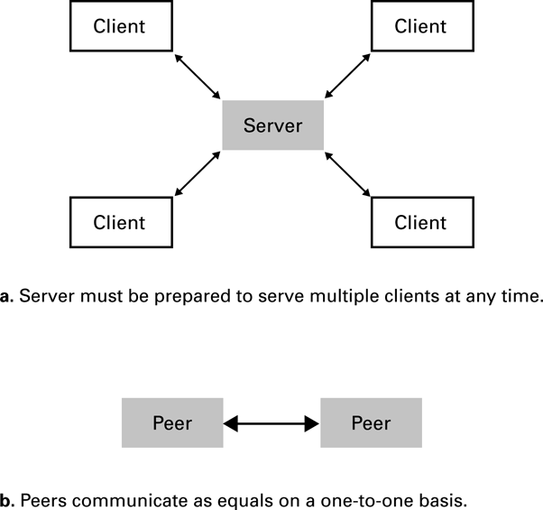
The client/server model compared to the peer-to-peer model
4-<number>

Slide 45
Why P2P Model replace Client Server model for file sharing?
It distributes the service task over many peers rather than concentrating it at one server –
This lack of a centralized base of operation leads to a more efficient system.
Questionable legality, the lack of a central server makes legal efforts to enforce copyright laws more difficult.
4-<number>

Slide 46
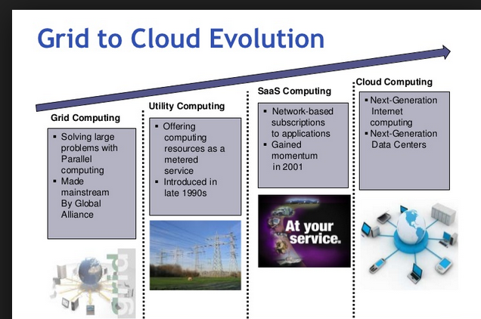
Distributed Systems
Software units that execute as processes on different computers
High-availability && Load-balancing
  Cluster computing
  Grid computing
  Cloud computing
    Amazon’s Elastic Compute Cloud
    Google Drive
4-<number>

Slide 47
Grid Computing
More loosely coupled than clusters
still work together to accomplish large tasks
can involve specialized software to make it easier to distribute data and algorithms to the machines participating in a grid
Examples:
  University of Wisconsin’s Condor system, or
  Berkeley’s Open Infrastructure for Network Computing (BOINC).
4-<number>

Slide 48
Grid Computing
Both Condor and BOINC are often installed on computers that are used for other purposes, such as PCs at work or at home,
They then volunteer computing power to the grid when the machine is not otherwise being used.
This type of voluntary, distributed grid computing has enabled millions of home PCs to work on enormously complex mathematical and scientific problems through internet.
4-<number>

Slide 49
Cloud Computing
Huge pools of shared computers on the network can be allocated for use by clients as needed
Similar to electrical grids, cloud refers to the enormous computing resources already available on the network
Provide reasonable guarantees of reliability and scalability,
But also raise concerns about privacy and security in a world (we may no longer know who owns and operates the computers that we use.)
4-<number>

Slide 50
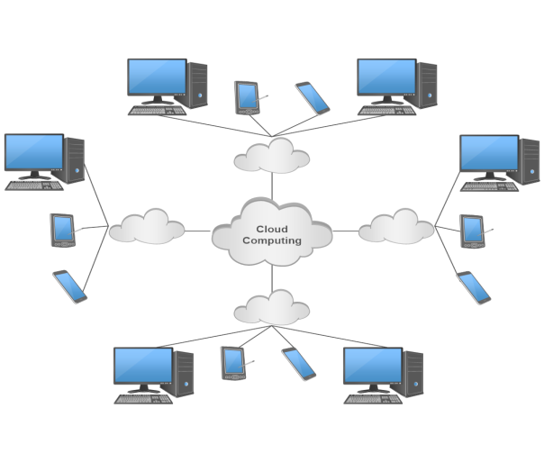
Examples of Cloud
Amazon’s Elastic Compute Cloud
  allow clients to rent virtual computers by the hour
  no concern for where the computer hardware is actually located.
Google Drive and Google Apps
  allow users to collaborate on information or build
  Web services
  No need to know how many computers are working on the problem or
  where the relevant data are stored.
4-<number>

Slide 51
The Internet
The Internet: An internet that spans the world
  Original goal was to develop a means of connecting networks that would not be disrupted by local disasters
      Defense Advanced Research Projects Agency (DARPA)
  Today a commercial undertaking that links a worldwide combination of PANs, LANs, MANs, and WANs involving millions of computers
4-<number>

Slide 52
Internet Architecture
Internet Service Provider (ISP)
  Organizations in which helps to construct and maintain the networks.
  Tier-1
    High-speed, high-capacity, international WANs
    Backbone of the internet
    typically operated by large companies that are in the communications business
  Tier-2
    More regional in scope and less potent in their capabilities
Tier-1 and tier-2 ISPs are essentially networks of routers that collectively provide the Internet’s communication infrastructure (core of internet)
4-<number>

Slide 53
Internet Architecture
Access or tier-3 ISP: Provides connectivity to the Internet (core)
Could be an independent internet (or intranet)
Operated by a single authority that is in the business of supplying Internet access to individual homes and businesses.
Examples:
  Cable and telephone companies that charge for their service
  organizations such as universities or corporations that take it upon themselves to provide Internet access to individuals within their organizations.
4-<number>

Slide 54
End Systems or hosts
    The devices that individual users connect to the access ISPs
End Systems /Hosts – may be laptops or PCs, telephones, video cameras, automobiles, and home appliances
Hot spot (wireless)
  The area within the AP or group of APs’ range
    Telephone lines
      Dial-up
      DSL (digital subscriber line )
      Modems
provide direct connection to an end system or to a customer’s router to which multiple end systems are connected
    Telephone, cable television, and satellite wide area networks
    Issues arising from these legacy analog linkages are often referred to collectively as the last mile problem.
    fiber optics - high-speed digital technology
4-<number>

Slide 55
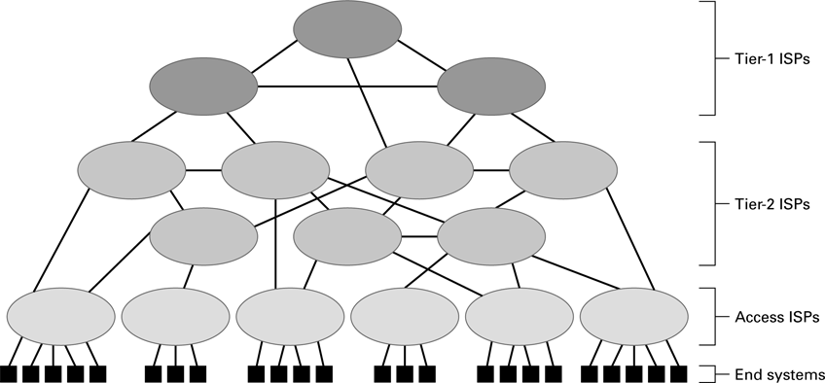
Internet Composition
4-<number>

Slide 56
Internet Addressing
IP address: pattern of 32 or 128 bits often represented in dotted decimal notation.
Blocks of consecutively numbered IP addresses are awarded to ISPs by the Internet Corporation for Assigned Names and Numbers (ICANN), which is a nonprofit corporation established to coordinate the Internet’s operation.
Allocate the addresses within their awarded blocks to machines within their region of authority.
Dotted decimal notation – Example: 192.207.177.133 (32 – bit pattern)
Alternative addressing system in which machines are identified by mnemonic names – domain – Registrars – ICANN- domain name- unique among all the domain names throughout the Internet. E.g. amrita.edu
4-<number>

Slide 57
Internet Addressing
Top-level domains (TLDs)
domain name of the Addison-Wesley publishing company is aw.com – commercial.
gov , edu, net, info, org, net, museum and so on ..,
Country-code TLDs , au for Australia and ca for Canada, in for India.
Subdomains, ssenterprise.aw.com, r2d2.compsc.nowhereu.edu
Domain Name Servers (DNS), Internet's equivalent of a phone book. They maintain a directory of domain names and translate them to Internet Protocol (IP) addresses.
Process of using the DNS to perform a translation is called a DNS lookup
4-<number>

Slide 58
Sub Domains
means of organizing the names within a domain
often represent different networks within the domain’s jurisdiction
Example: overthruster.propulsion.yoyodyne.com
the computer overthruster is in the subdomain propulsion within the domain yoyodyne within the TLD com.
4-<number>

Slide 59
Internet Applications
Before HTTP – NNTP, FTP, Telnnet, SSH
Electronic Mail
Mail server - Microsoft’s Outlook, Apple’s Mail, or Mozilla’s Thunderbird
to read and compose their email
  SMTP (Simple Mail Transfer Protocol), send a new message from its author’s local machine to the author’s mail server.
  MIME (Multipurpose Internet Mail Extensions), non-ASCII data to SMTP
  POP3 (Post Office Protocol version 3) and IMAP (Internet Mail Access Protocol), accessing email that has arrived and accumulated at a user’s mail server
4-<number>

Slide 60
Internet Applications
The File Transfer Protocol, which is a client/server protocol for transferring files across the Internet.
Example
FTP sites are also used to provide unrestricted access to files.
Anonymous as a universal login name, anonymous FTP.
4-<number>

Slide 61
Internet Applications
Telnet:
    Computer users to access computers from great distances.
    Contact the telnet server at a distant computer.
    Distant user has the same access to the applications and utilities on the computer that a local user.
    No Encryption
  Secure Shell (SSH),
    Encryption of data being transferred as well as authentication.
4-<number>

Slide 62
Internet Applications
VoIP (Voice over Internet Protocol): Internet infrastructure is used to provide voice communication similar to that of traditional telephone systems.
  Soft phones,
    P2P software that allows two or more PCs to share a call with no more special hardware than a speaker and a microphone.
    Skype , example for Soft Phones.
  Analog telephone adapters,
      ATA, is a device used to connect one or more standard analog telephones to a digital telephone system (such as voice over IP) or a non-standard telephone system (modem).
  Embedded VoIP phones,
      Handset Connected directly to a TCP/IP network (VOIP over ethernet – used by companies for cost cutting
  smart phones are slated to use VoIP technology (4G).
4-<number>

Slide 63
More Recent Applications
Webcasting Vs. Broadcasting
Internet Radio
  Internet Multimedia Streaming
    Netflix, Youtube etc.
    N-unicast - single sender involved with multiple unicasts
    substantial burden on the station’s server as well as on the server’s immediate Internet neighbors
    Multicast burden distributed to routers (expanding the capability of routers
  On-demand streaming through content delivery networks (CDNs),
4-<number>

Slide 64
World Wide Web
Hypertext combines internet technology with concept of linked-documents
  Embeds hyperlinks to other documents
  Hyper media
Browsers present materials to the user
World Wide Web
  Web page and Web site
Webservers provide access to documents
Documents are identified by URLs and transferred using HTTP
4-<number>

Slide 65
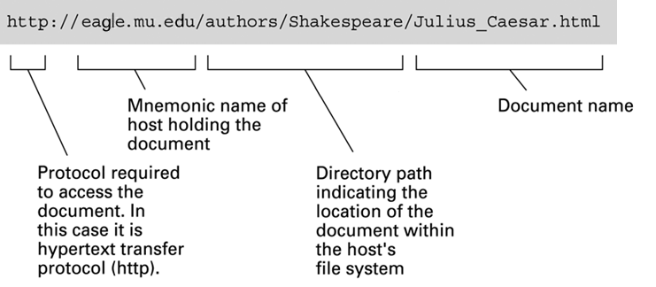
A typical URL
4-<number>

Slide 66
Hypertext Markup Language (HTML)
Encoded character by character as text file
Contains tags to communicate with browser
  Appearance
    <h1> to start a level one heading
    <p> to start a new paragraph
  Links to other documents and content
    <a href = . . . >
  Insert images
    <img src = . . . >
4-<number>

Slide 67
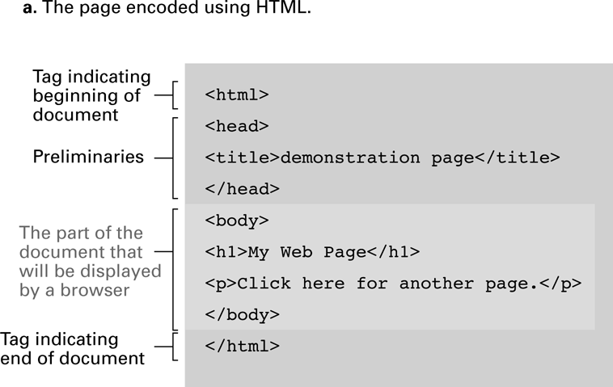
A simple webpage
4-<number>

Slide 68
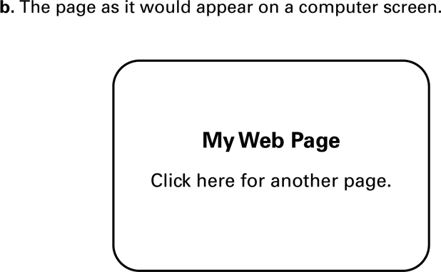
A simple webpage (continued)
4-<number>

Slide 69
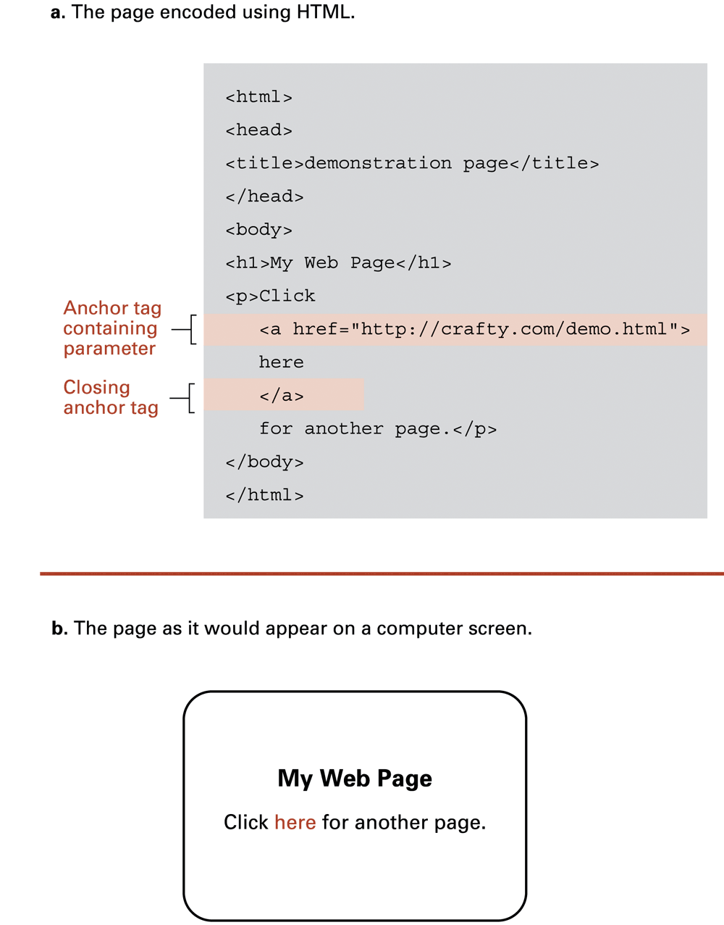
An enhanced simple webpage
4-<number>

Slide 70
An enhanced simple Web page (continued)
4-<number>

Slide 71
<html>
<body>
<img src="E:\\IMG_20180117_212033.jpg" alt="Mountain View" width="500" height="377">
</body>
</html>
4-<number>

Slide 72
Extensible Markup Language (XML)
XML: A language for constructing markup languages similar to HTML
  A descendant of SGML (Standard Generalized Markup Language)
  Opens door to a World Wide Semantic Web
4-<number>

Slide 73
Using XML
<staff clef = “treble”> <key>C minor</key>
<time> 2/4 </time>
<measure> < rest> egth </rest> <notes> egth G, egth G, egth G </notes></measure>
<measure> <notes> hlf E </notes></measure>
</staff>
<note>
<to>Tove</to>
<from>Jani</from>
<heading>Reminder</heading>
<body>Don't forget me this weekend!</body>
</note>
4-<number>

Slide 74
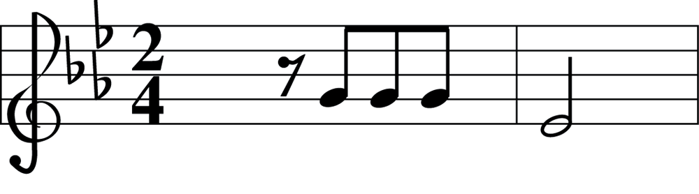
The first two bars of Beethoven’s Fifth Symphony
4-<number>

Slide 75
Client Side Versus Server Side
Client-side activities
  Javascript
  Macromedia Flash
Server-side activities
  Common Gateway Interface (CGI)
  Servlets
  JavaServer Pages (JSP) / Active Server Pages (ASP)
  PHP
4-<number>

